Slide 1

Project - In Progress DEMO
CIT 41200 – Data Driven Cloud Applications
Team Orange

Slide 2
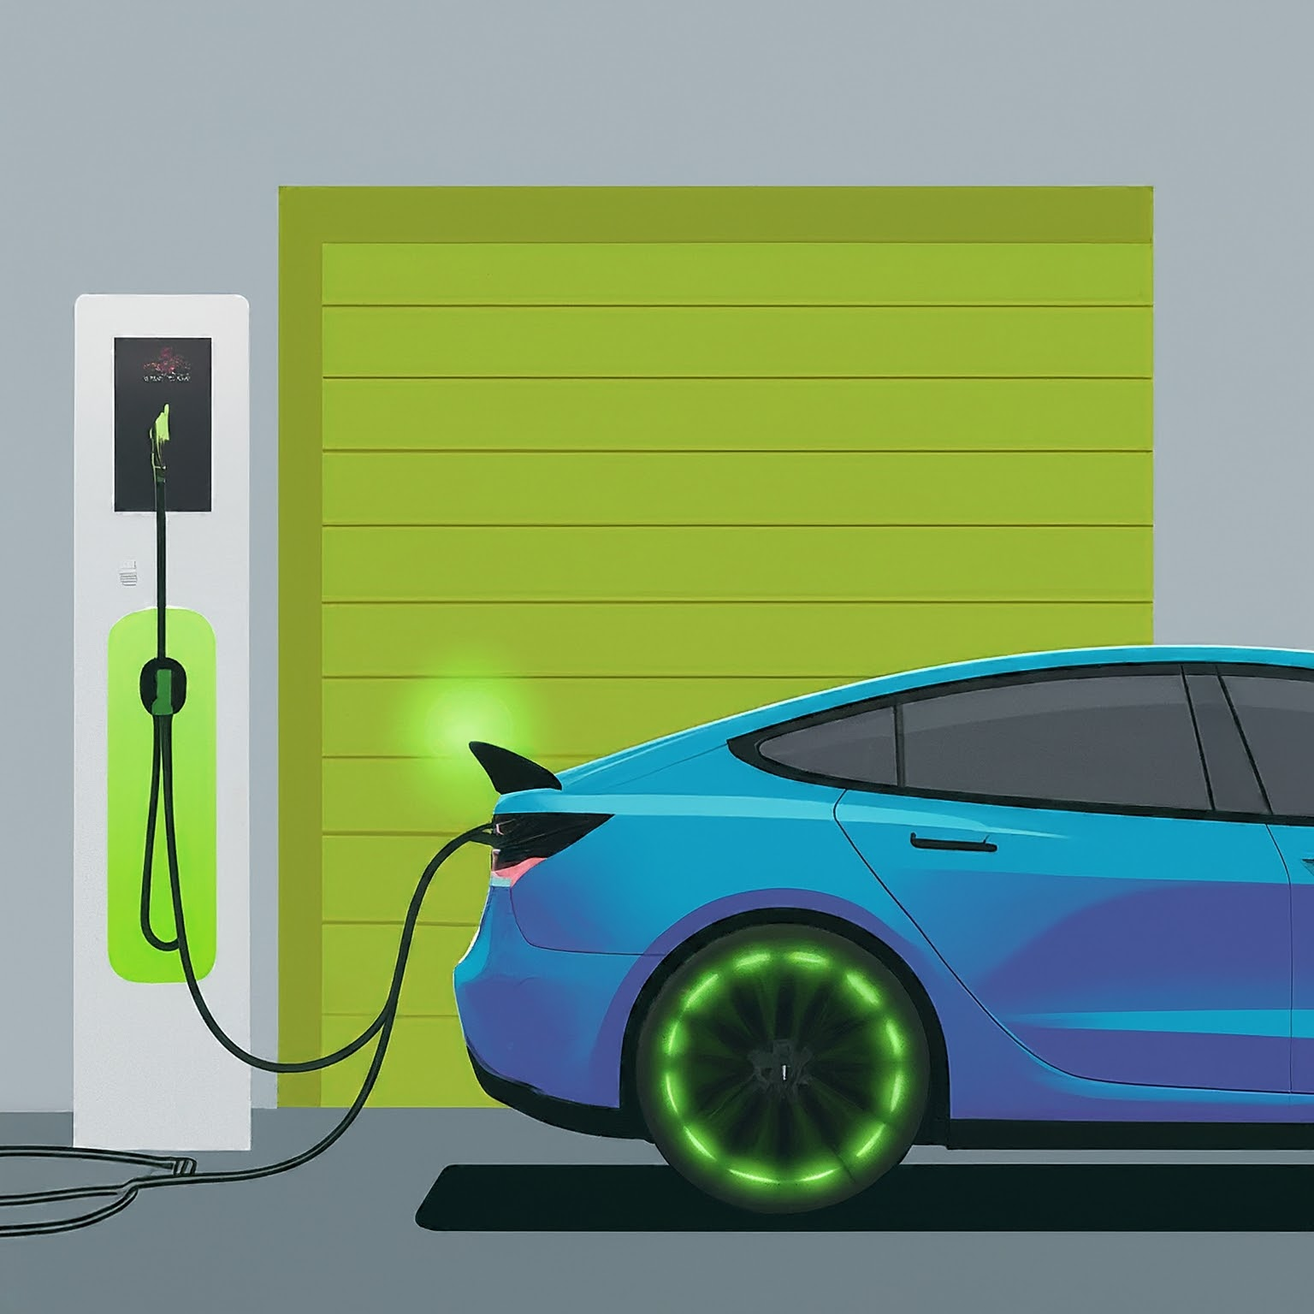
Project Description
TOPIC
Electric Vehicle Tax Credit Eligibility System (EVT-CES)
DESCRIPTION
EVT-CES is a web-based application that leverages Firebase (Firestore) and BigQuery to provide users with detailed information on electric vehicles (EVs), focusing on their eligibility for tax credits under the Inflation Reduction Act. It assesses vehicles based on manufacturing location, battery production, and sourcing of critical minerals, offering an invaluable tool for consumers seeking eco-friendly transportation options that qualify for financial incentives.

Slide 3







What Problem does this Application Solve?
BEFORE APPLICATION
Users had to ask dealers about whether a new car they would like to purchase qualifies for EV Tax credits.
Car Dealership
Give Car Form
Dealer Verifies
Customers
AFTER NEW APPLICATION
The application will make the process simpler for the user by allowing them to input details from the manufacturers document.
Customers/Users
Documents
EV Tax Credit Result

Slide 4








Technology Stack
Technology Stack LOCKED
1.
2.
3.
4.
HTML
CSS
JAVASCRIPT
NODE.JS
5.
6.
7.
FIREBASE
BIGQUERY
GOOGLE MAPS

Slide 5

Databases Utilized
Database (SQL, NoSQL) LOCKED
FIRESTORE
BIGQUERY
Database Names:
default
Database Name:
CreditTracking
Table Name: Vehicles
Userdetails
- userdetails
Logic under - development
default
Manufacturer
Make
countryOfOrigin
barcodeID
eligibilty
price
Model
VIN
{
"Ub6gUTjDz3B3SwdwCqXE": {
"manufacturer": "Ford",
"manufacturingCoordinates": {
"latitude": 19.6431,
"longitude": 99.2151
},
"model": "Mach E",
"nickelSource": "China",
"price": 55999,
"reasons": ["Assembly and sourcing from North America"],
"typeOfBattery": "Lithium-ion",
"
First Name
Last Name
VIN
Purchase_Price
License_ID
License_Plate

Slide 6
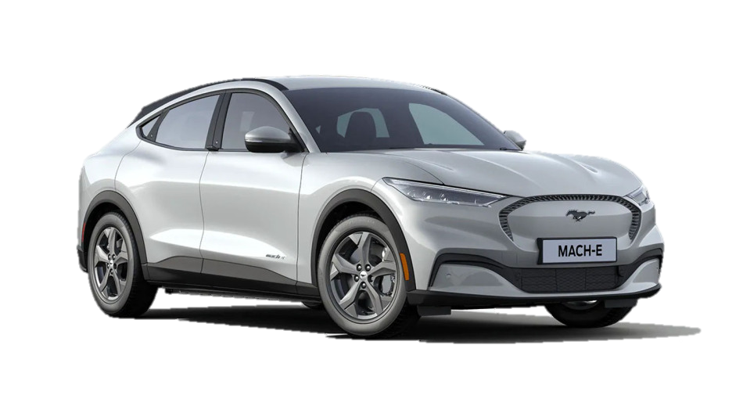
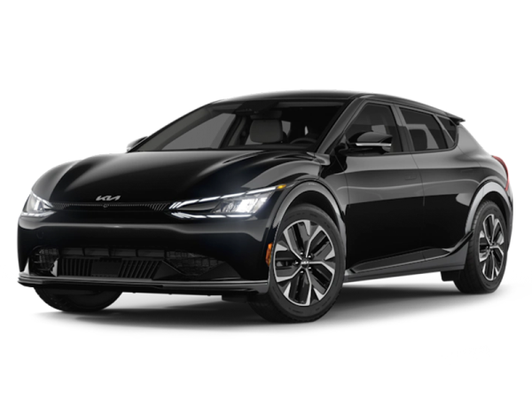
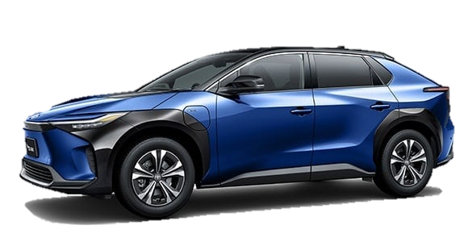
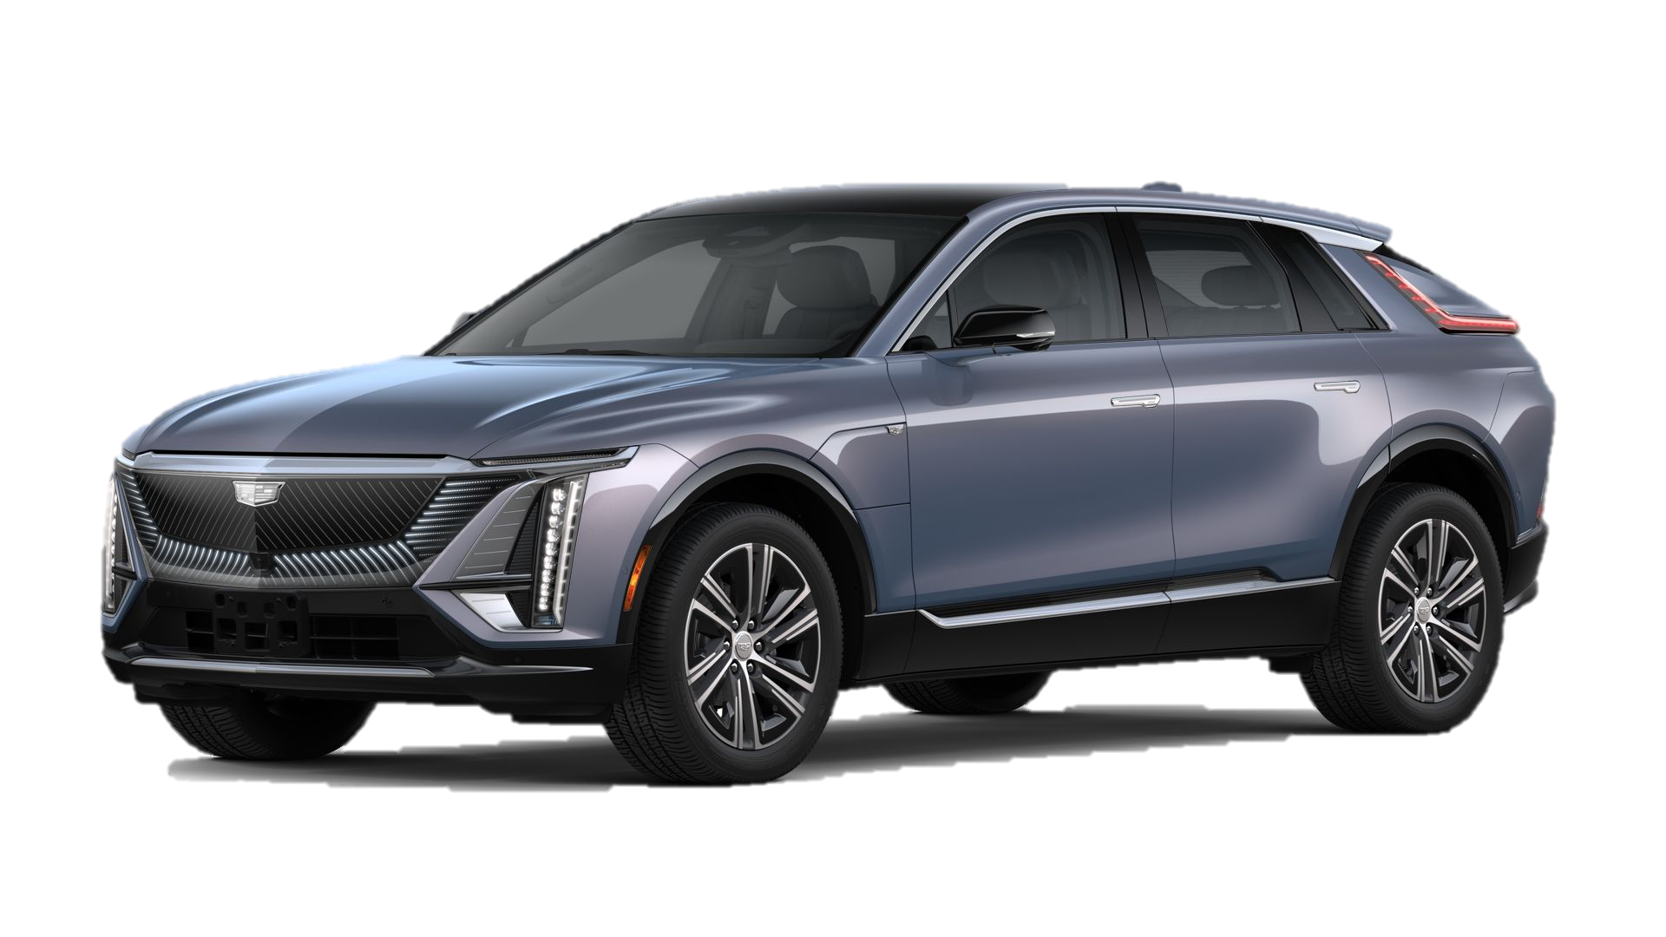





How the Javascript Tax Credit Logic Works
FORD MACH E
KIA EV6
TOYOTA BZ4X
CADILLAC LYRIC
Country Of Origin:
Country Of Origin:
Country Of Origin:
Country Of Origin:
Minerals Sourcing: China, Mexico
Minerals Sourcing: Argentina, Philippines
Minerals Sourcing: Japan, China, Vietnam
Minerals Sourcing: USA, Mexico, China
Assembly Plant Location: Cautitlan, Mexico
Assembly Plant Location: Hwasung, South Korea
Assembly Plant Location: Aichi, Japan
Assembly Plant Location: Tennessee, USA
The Javascript logic first checks whether the minerals are sourced from US Free Trade countries. If the country is China, it automatically disqualifies the vehicle for EV Tax credit eligibility.
If the country is in North America, the vehicle qualifies for the EV Tax Credit.
CalculateTaxCreditCloud Function
app.js
Javascript Logic

Slide 7



Cloud Functions
User – Interface (UNDER – DEVELOPMENT)
calculateTaxCredit
showGoogleMapsLocation

Slide 8
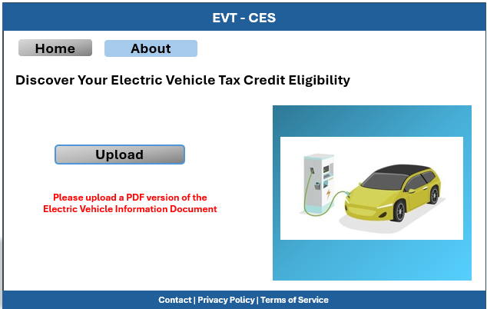
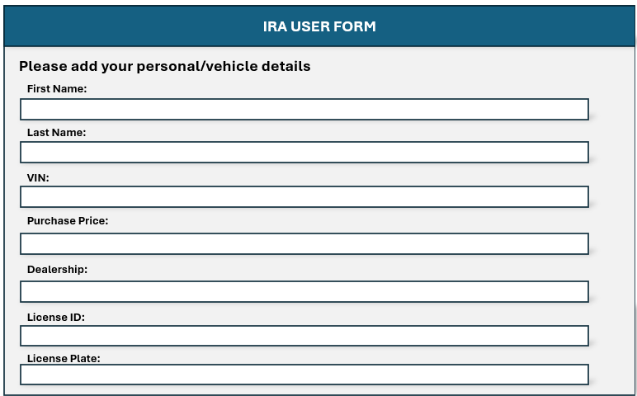
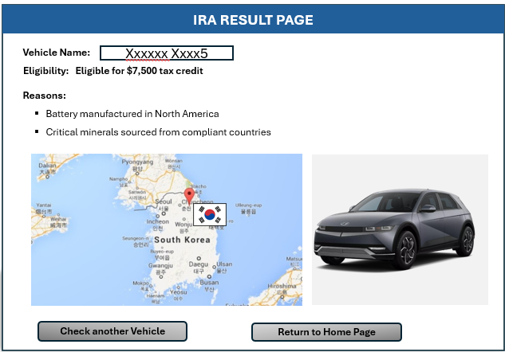





Project Architecture
Eligibility logic
Maps
User uploads a PDF of the Electric Vehicle Details Document
The user inputs details
Javascript Logic calculates whether an EV qualifies for the tax credit. The user gets report including Assembly Plant Location
default database
CreditTracking Database
userdetails Database
FIRESTORE
BIGQUERY
BIGQUERY

Slide 9

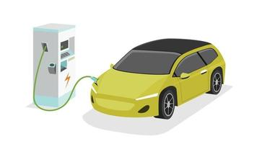
Index.html (PAGE 1)
UI Design: LOCKED
Simple Design = Less Lead Time
EVT - CES
Home
About
Discover Your Electric Vehicle Tax Credit Eligibility
Choose file
Upload

Slide 10
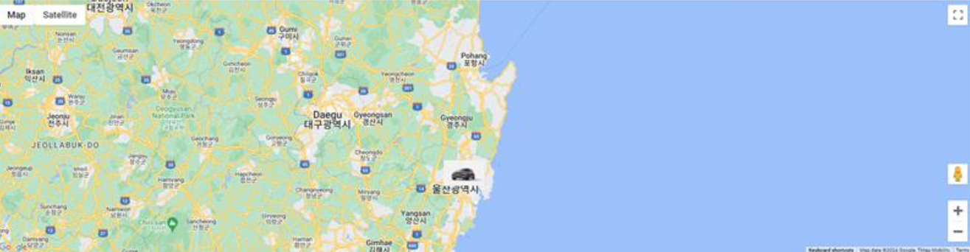
EV TAX CREDIT PAGE
Submit
YOUR EV QUALIFIES FOR A $7500 CREDIT
Back to homepage

Slide 11
UI - PAGE 2 (summary.html)
UI Design: LOCKED
IRA USER FORM
Simple Design = Less Lead Time
Please add your personal/vehicle details
First Name:
Last Name:
VIN:
Purchase Price:
License ID:
License Plate:

Slide 12

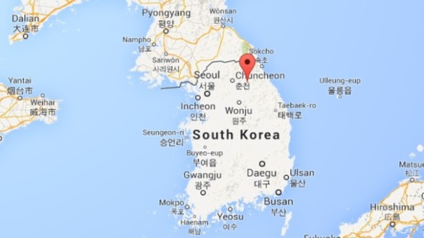
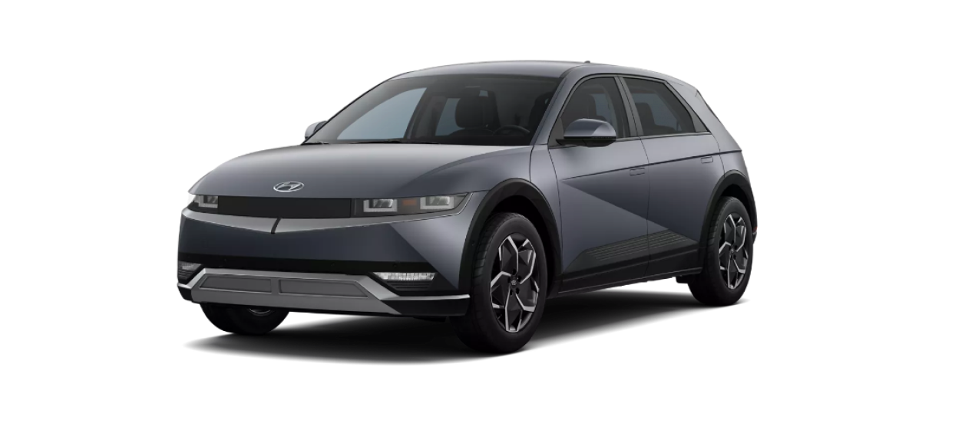

Final Page (result.html)
UI Design: NOT LOCKED
Under - development
IRA RESULT PAGE
Simple Design = Less Lead Time
Vehicle Name:
Xxxxxx Xxxx5
Eligible for $7,500 tax credit
Eligibility:
Reasons:
Battery manufactured in North America
Critical minerals sourced from compliant countries
Check another Vehicle
Return to Home Page

Slide 13
Project Completion Timeline
April 9th – 15th
April 16th – 20th
April 21st – 25th
April 30th
Research & Develop
Start Coding
Finalize Project
Testing

Slide 14
THANK YOU

Slide 15
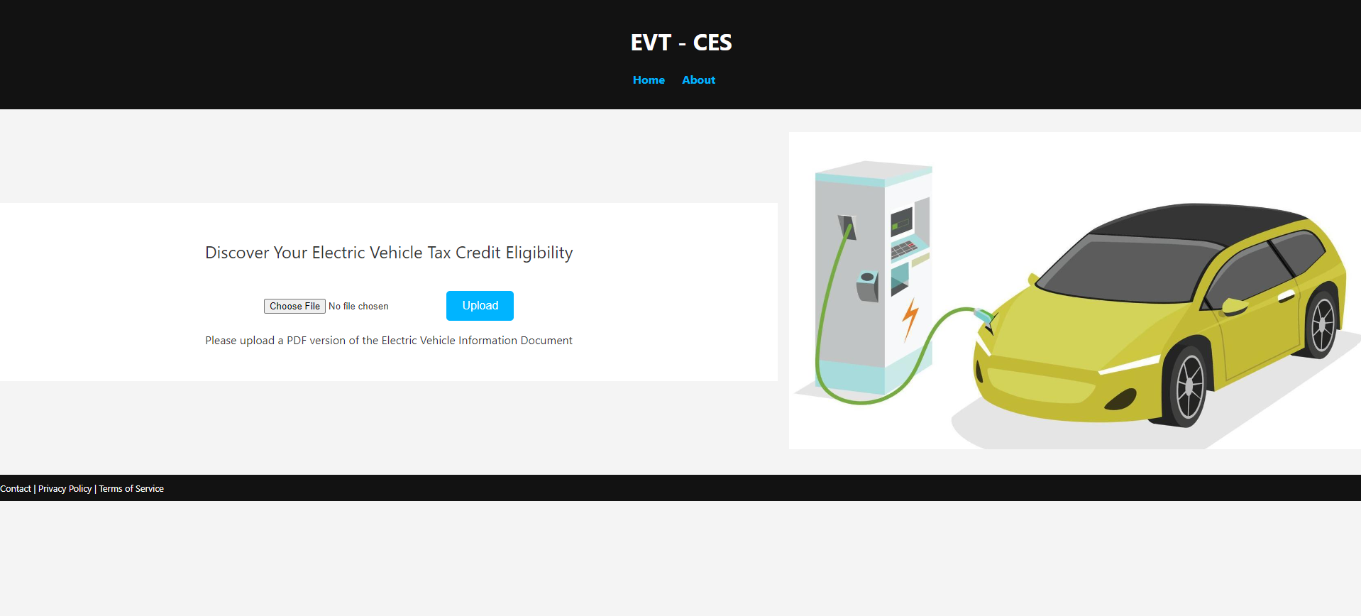

Slide 16
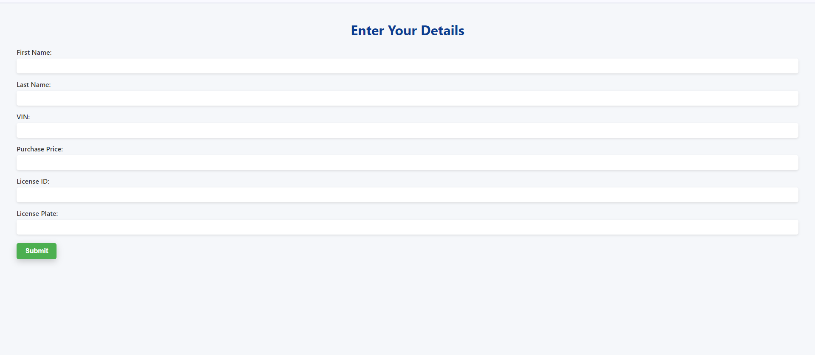

Slide 17
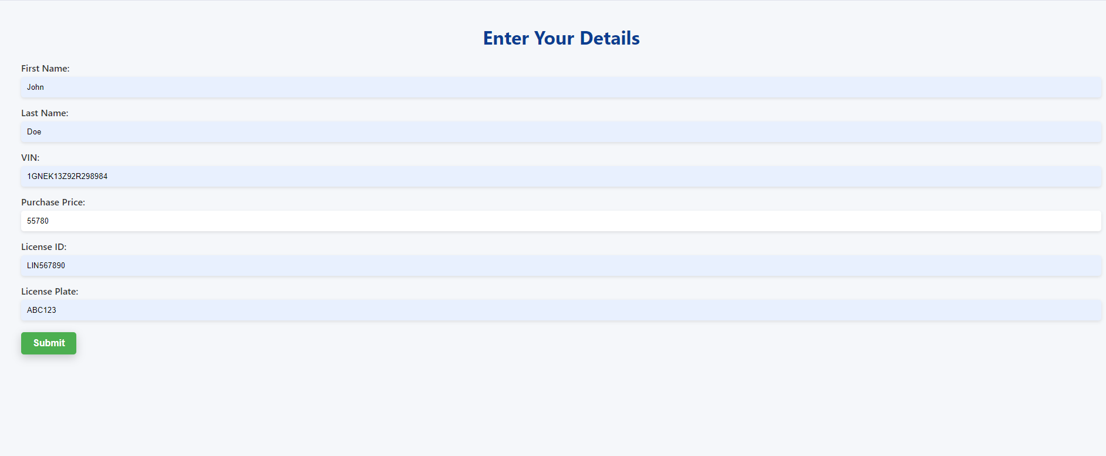

Slide 18
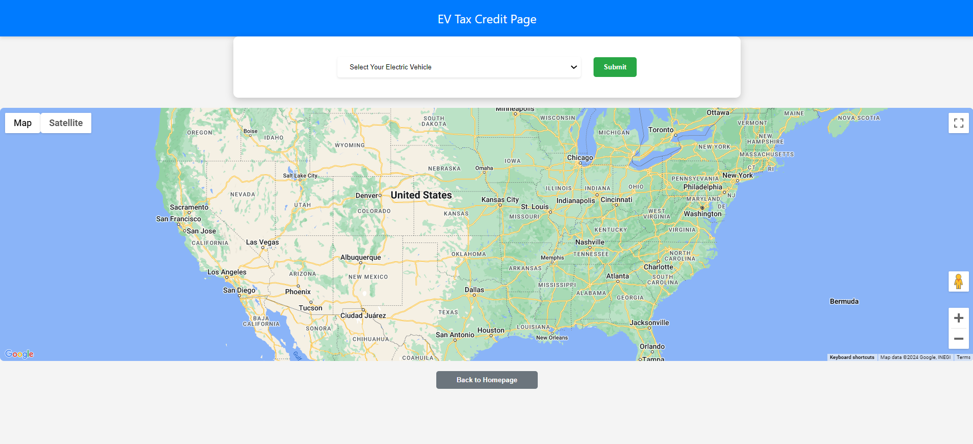

Slide 19
